Slide 1
Reinforcement Learning Final Project Farmer's helper
Reporter: Fang Jia Ye
Student ID:61075070H

Slide 2

Goal
A drone with a watering system uses Q-learning to irrigate the farmland until the soil moisture reaches sufficient moisture. In order to solve the problem of food crisis in the future and also can reduce the manpower.
Notes:
Thus, I will propose a way that a drone with the watering system to fix this situation.

Slide 3
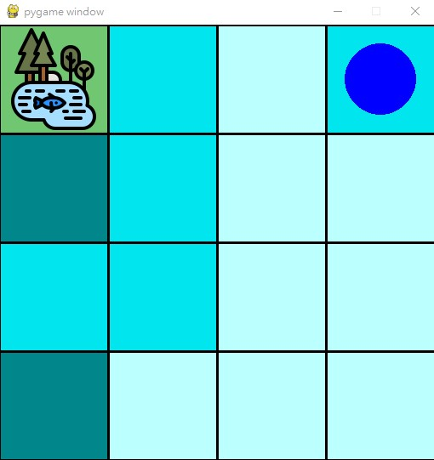
Environment
Using the Open AI gym toolkit to built environment and pygame to display.
Agent
The drone (blue circle)
Actions
right,left,up,down,water
State
The state of agent * The state of ground moisture (* The state of tank capacity )
Notes:
Thus, I will propose a way that a drone with the watering system to fix this situation.

Slide 4
Reward()
If terminated , reward = 1000
If agent out of the farm, reward = -100
#watering (if agent not at pound and choses action water)
If no water in tank , reward = -100
If water in tank and ground is not wet enough , reward = 50
If water in tank and ground is wet enough ,reward = -100
#refill the tank (if agent at pound)
If the water in tank small or equal than 2 , reward = 10
Else if agent refill the tank ,reward = -20
#other
According above cases, the total reward is:
Reward=reward + (-1+ the sum of ground moisture/ the size of farm )
Notes:
Thus, I will propose a way that a drone with the watering system to fix this situation.

Slide 5

Problem
Problem :The larger states let to a memory error that can not be fixed.
(the size of farm more than 4*4 or the state of ground moisture more than 2 )
Version 1: Observation space does not include tank capacity (can not reach the goal)
Version 2: Observation space include tank capacity (can reach the goal)
Solution: Use version 2 , limit farm's size to 4*4 and soil max moisture to state to 2.
Notes:
Thus, I will propose a way that a drone with the watering system to fix this situation.

Slide 6
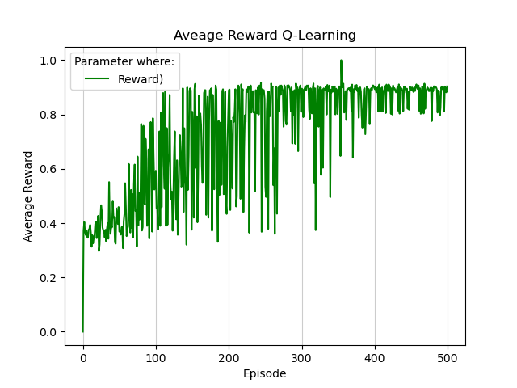
Performance
Notes:
Thus, I will propose a way that a drone with the watering system to fix this situation.

Slide 7
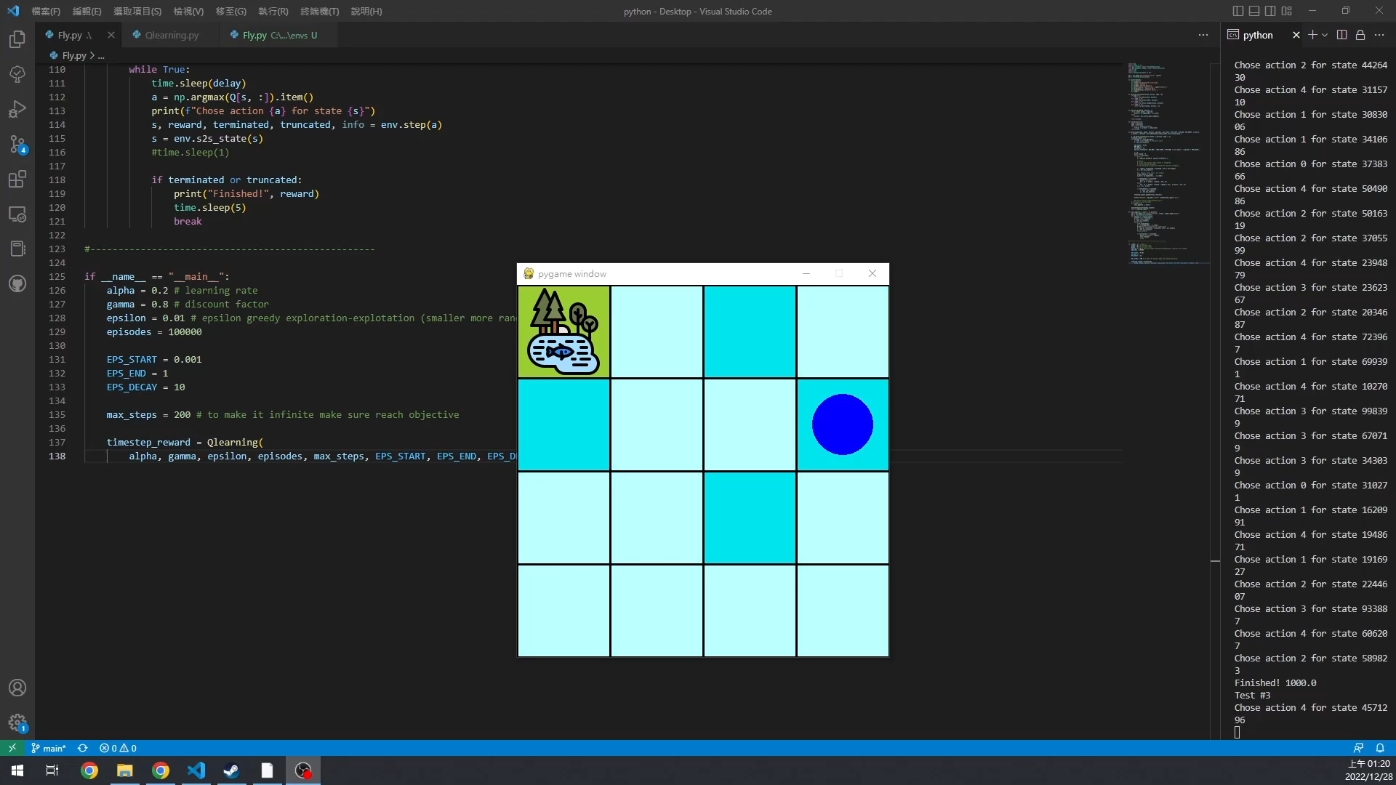
Demo
(States=4*4*10*2^15=5242880 Episode=100000 Max steps=200)
Notes:
Thus, I will propose a way that a drone with the watering system to fix this situation.

Slide 8
Thank for your listening

